Slide 1
All Roads lead to philosophy
Austin Barish

Slide 2
Wikipedia overview

Slide 3
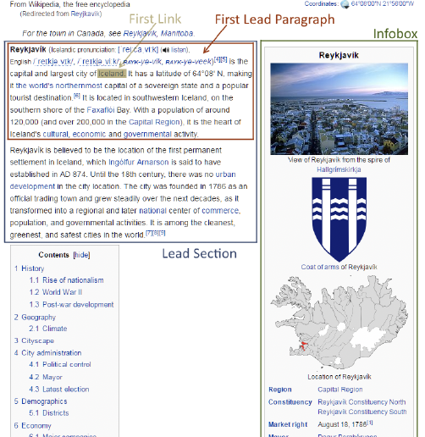
Page Structure
The first link is the first link in the paragraph content itself
Excludes citations and pronunciation
I will be all but entirely focused on the lead paragraph
¹ Evaluating and Improving Navigability of Wikipedia: A Comparative Study of Eight Language Editions, 2016, Daniel Lamprecht, Markus Strohmaier, OpenSym '16: Proceedings of the 12th International Symposium on Open Collaboration

Slide 4
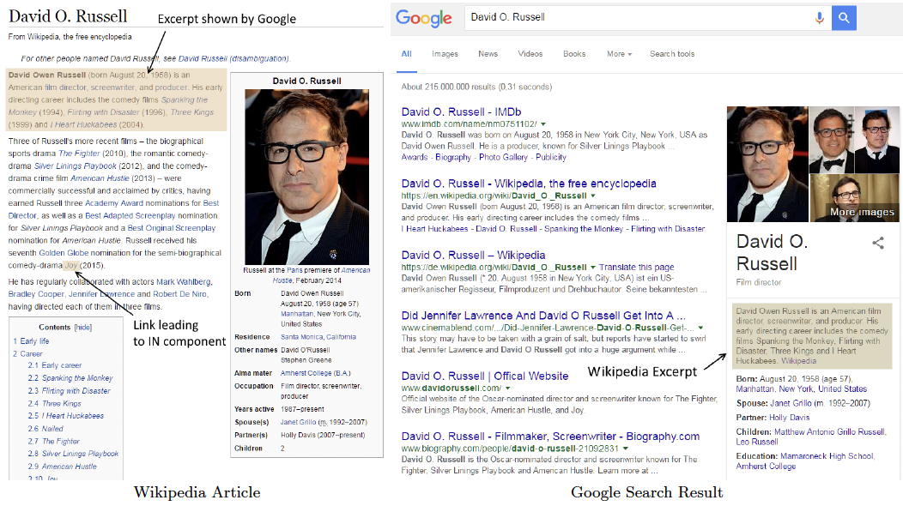
Lead Paragraph
“In Wikipedia, the lead section is an introduction to an article and a summary of its most important contents. It is located at the beginning of the article, before the table of contents and the first heading. It is not a news-style lead or "lede" paragraph.
The average Wikipedia visit is a few minutes long. The lead is the first thing most people will read upon arriving at an article and may be the only portion of the article that they read. It gives the basics in a nutshell and cultivates interest in reading on—though not by teasing the reader or hinting at what follows. It should be written in a clear, accessible style with a neutral point of view.”²
¹ Evaluating and Improving Navigability of Wikipedia: A Comparative Study of Eight Language Editions, 2016, Daniel Lamprecht, Markus Strohmaier, OpenSym '16: Proceedings of the 12th International Symposium on Open Collaboration
² “Wikipedia:Manual of Style/Lead section.” Wikipedia, 2023, https://en.wikipedia.org/wiki/Wikipedia:Manual_of_Style/Lead_section. Accessed 8 July 2023.

Slide 5
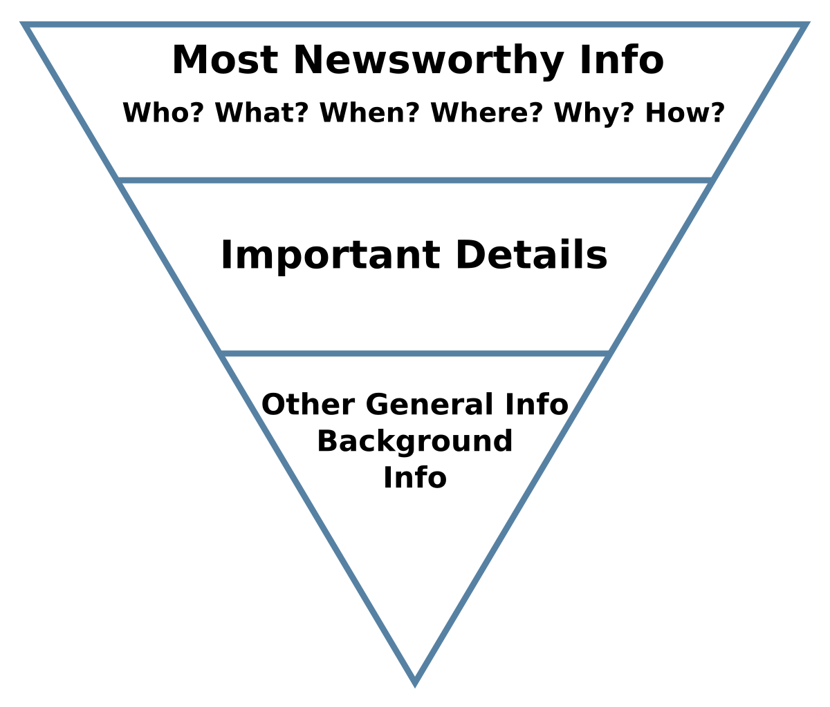
Opening Sentence
“The first sentence should tell the nonspecialist reader what or who the subject is, and often when or where. It should be in plain English.”²
² “Wikipedia:Manual of Style/Lead section.” Wikipedia, 2023, https://en.wikipedia.org/wiki/Wikipedia:Manual_of_Style/Lead_section. Accessed 8 July 2023.
“Inverted pyramid (journalism).” Wikipedia, https://en.wikipedia.org/wiki/Inverted_pyramid_%28journalism%29. Accessed 8 July 2023.

Slide 6
Leading Paragraph Links
Barack Obama
Person
President of the United States
Topic where the person achieved prominence
“The first sentence should provide links to the broader or more elementary topics that are important to the article's topic or place it into the context where it is notable.”²
Social network analysis
Technical or Jargon Term
Networks
Field of Study
Georgetown University
Building or Location
Washington DC
Broader Geographical Area
² “Wikipedia:Manual of Style/Lead section.” Wikipedia, 2023, https://en.wikipedia.org/wiki/Wikipedia:Manual_of_Style/Lead_section. Accessed 8 July 2023.

